Slide 1
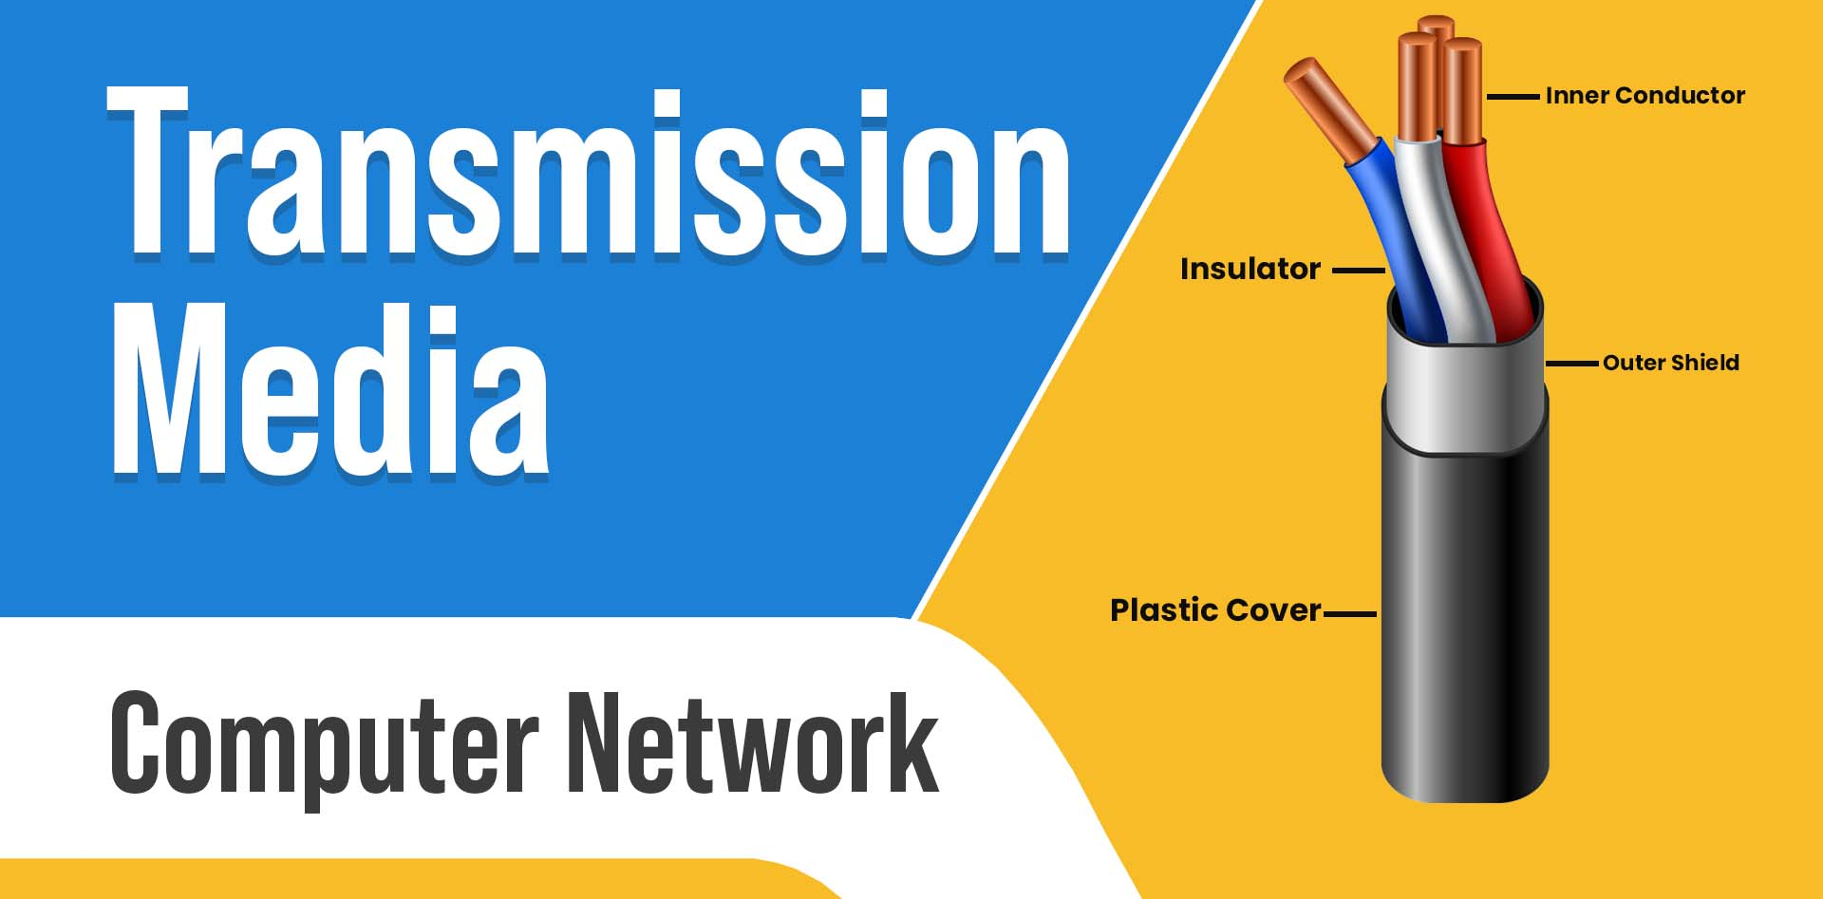
A Level Digital Technology | Mr Butler

Slide 2
What we need to know
Define the Terms Bandwidth and Broadband
Describe the transmission media:
  Metal Cable
  Fibre Optic
  Wireless
Evaluate these transmission media in terms of volume of data transfer, bandwidth and security

Slide 3
Define the Term Broadband
This is a popular name given to a method of connecting to the internet, usually achieved by a technique known as digital subscriber line (DSL).
This uses the physical connections of the telephone system, but transmits data in a way that does not interfere with the voice frequencies.
Consequences of this are that data can be transmitted very much faster than over a dial-up connection, that ordinary voice calls are possible at the same time, and that there are no separate call charges for computer connection.
broadband is wide bandwidth data transmission which transports multiple signals and traffic types. The medium for this kind of data transfer can be coaxial cable, fibre optic, radio (wireless) or twisted pair.
  Usually, its bandwidth is in excess of 3kHz, but actually in practice over 300 MHz

Slide 4

Define the Term Bandwidth
This is a measure of the capacity of a communications channel. It is the range of frequencies that a channel can handle.
Bandwidth may be given as a frequency (range), such as 3kHz, or as a transmission rate in bits per second, such as 63 kbps.
Transmission rate is often referred to as line speed.
  For example, channels might be described as having line speeds of 56k or 64k, meaning 56 kbps or 64 kbps.
http://bit.ly/3YyxsQY

Slide 5
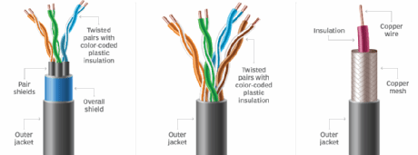
Describe Metal Cable in Data Transmission
There are 3 types of metal cabling we need to review;
  Unshielded Twisted Pair
  Shielded Twisted Pair
  Coaxial Cable
Used in ordinary telephone lines
Computer networking often uses UTP
Used in TV aerials and CCTV Cameras

Slide 6
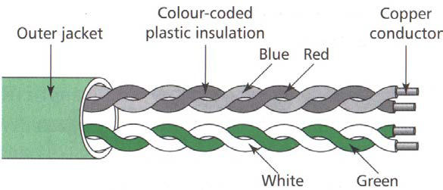
Metal Cable: UTP
There is no earthed shield on UTP
This is a very common type of cable, used for a wide variety of data transmission. You will often hear engineers using ‘Cat 5’ (Category 5) cabling for day to day networking solutions.
  A UTP cable will have plastic RJ45 connections at each end
In its simplest form it is a pair of insulated copper wires twisted together surrounded by a copper braid.
These pairs may be grouped to form a single multi-connector cable.
These cables all have different specifications and bandwidth capabilities.

Slide 7
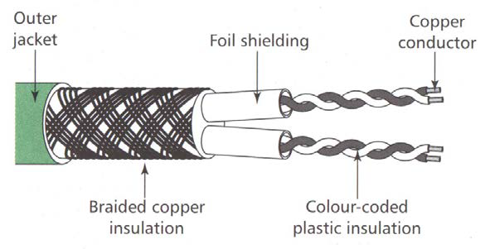
Metal Cable: STP
Has an earthed shield on STP, reducing interference from the likes of electromagnets/etc
  This shielding increases costs, especially when extensive cabling is used. This means it is only used where interference is common.
A STP cable will have metal RJ45 connections at each end
This cable is a pair of insulated copper wires twisted together surrounded by a copper braid and external insulation.
  Some cables are made up of a number of twisted pairs surrounded by an overall (earthed) braid screen.
  In another form, stranded copper wires are twisted together in pairs with an earth wire.
These pairs may be grouped to form a single multi-connector cable. These cables all have different specifications and, used in the correct situation, provide mini­mum interference data transmission.

Slide 8
The Categories of Twisted Pair Cables
Category | Purpose | Bandwidth | Data Transfer Rate
Cat1 | Voice Only (Analog phones) | N/A | N/A
Cat2 | Data (Old phones) | 4 MHz | 4 Mbps
Cat3 | Data (Phone and Fax) | 16 MHz | 16 Mbps
Cat4 | Data (Old computer networks) | 20 MHz | 16 Mbps
Cat5 | Data (Pretty standard) | 100 MHz | 100 Mbps
Cat5e | Data (I want more!) | 100 MHz | 1 Gbps
Cat6 | Data (I just like expensive things) | 250 MHz | Up to 10 Gbps
Cat6a | Data (Long distance) | 500 MHz | Up to 10 Gbps
Cat7 | Data (Long distance) | 600 MHz | Up to 10 Gbps
Cat7a | Data (Switch-Switch) | 1 GHz | 40-100 Gbps
Cat8 | Data (Server-Switch) | 2 GHz | 25-40 Gbps
Basically defunct now.
Common cabling to use.
Would need to be an expensive project!

Slide 9
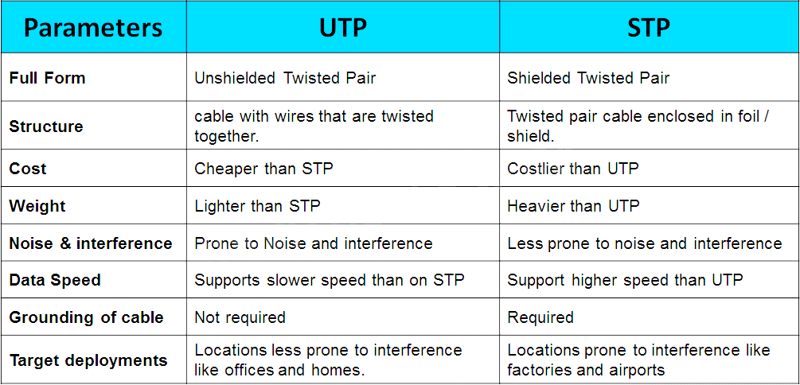
Comparing UTP and STP

Slide 10
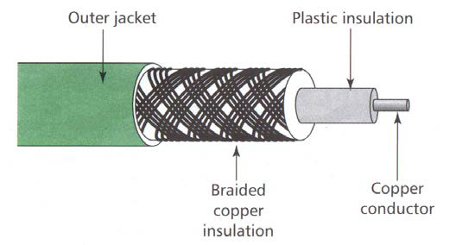
Metal Cabling: Coaxial
Made to a variety of specifications, is the same kind of cable that is used for connecting a television aerial to a television set.
It has two conductors.
  One is a wire down the centre of the cable, which may be a single strand
  This is insulated from the second, which is made up of many strands braided around the insulation for the inner wire.

Slide 11
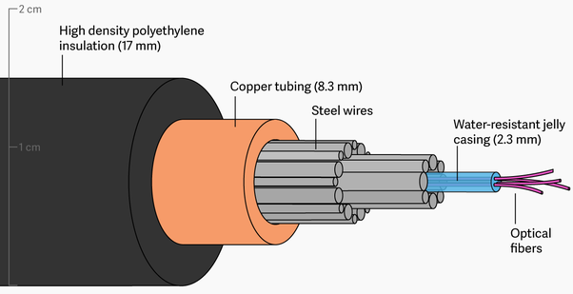
Fibre Optic Cabling
Greater bandwidth than metal cables, which means it has a bigger data capacity.
Less susceptible than metal cables to interference.
Data can be transmitted in digital form (the ‘natural’ form for a computer to use).
Data can travel in a secure way, impossible for hackers to intercept data.
This is a very fine glass strand that allows rapid transmission of data, using modulated light beams (pulses of light).
It is usual to put many strands together in a single cable, each one capable of carrying one or more data signals.
Fibre optic cable provides interference-free, secure data transmission and, unlike metal wires, is not subject to corrosion.
Data literally travels at the speed of light, and can travel much longer distances. However, costs a lot to install

Slide 12

Wireless (WiFi and Bluetooth)
WiFi (Wireless fidelity) is a way of connecting computers to a network by wireless.
Each computer has a Wi-Fi wireless interface that connects to a wireless access point attached to the network.
It is the most successful of several competing technologies, which include wireless mesh.
Bluetooth is a short range wireless communications standard that uses low-power radio waves.
It allows Bluetooth equipped devices to communicate with other Bluetooth devices in a peer-to-peer relationship.
If one of the devices is a computer then it can act as a gateway onto a network.
  An example is a mobile phone with a separate earpiece linked using Bluetooth wireless communication.

Slide 13
Sending Data Via WiFi
Both must be connected to the same router/WAP
File sharing must be enabled on both the computer and device
The computer will display the devices on the network
The mobile device will be selected, meaning at this point the data will be transferred via the router

Slide 14
Sending Data Via Bluetooth
Both must be Bluetooth enabled devices
The computer will display the devices within range which are set to visible.
The mobile device will be selected, which may require pairing via a passcode
A piconet is created

Slide 15

Activity
Look at https://www.bbc.co.uk/bitesize/guides/zj88jty/revision/4
Use this to add annotations to your notes.
You can complete the test for some basic questions, however expect your responses to be extended questions in the real exam.
Notes:
https://www.bbc.co.uk/bitesize/guides/zj88jty/revision/4

Slide 16
Evaluation between Volume of Data Transfer, Bandwidth and Security
Transmission Media | Volume of data transfer | Bandwidth | Security*
Twisted Pair (metal cable) | Depends on the category, but generally between < 100 Kbps and 100 Mbps and higher | Low | Low
Co-axial (metal cable) | Up to 10Mbps | Moderately high | Fair
Fibre Optic | 100Mbps – 2Gbps | Very high | Very High
Bluetooth (Wireless) | Up to 25Mbps | Low | Low (but improving with 5.0)
Wi-Fi (Wireless) | Up to 250Mbps (though steadily improving) | High | Very Low
*Security is always affected by use of encryption/etc.

